Slide 1



Serious Game Development
for chronic disease management
National Centre of Scientific Research "Demokritos"
&
University of Piraeus
Supervisor: Dr. Ilias Magklogiannis Author: Alexandros Filios

Slide 2
OUR PROCESS
QUARTER 1
QUARTER 3
SUMMER
DATA GATHERING & DESIGN
VISUALS & GAME DEV
REFINEMENT AND COMMENT RESOLVE
QUARTER 2
QUARTER 4
DATA STRUCTURE
OPTIMIZATION AND ADDITIONS

Slide 3
TABLE OF CONTENTS
01.
02.
03.
Introduction
LITERATURE REVIEW
DeSIGN
04.
05.
06.
Methodology
EXPERIMENTS
DISCUSSION
Background, Motivation, Objectives, Scope and Limitations.
Serious Games in Health Management, Tools and Platforms, Stress measurement
3D Modeling, Texturing, Color theory, Low poly
Use cases, Data Gathering, Utilization and Implementation
Chatbot Interaction analysis and Results. HRV metric
Research outcomes, advancements, future directions and recommendations

Slide 4
01.
INTRODUCTION
Why, How and What?

Slide 5
Introduction
BackGround & Motivation

Slide 6

BackGround & Motivation
User disengagement with current health apps due to monotonous interfaces.
Need for visually intuitive and interactive health apps.
Leveraging AI and serious games for chronic disease management.

Slide 7
Introduction
BackGround & Motivation
Problem statement

Slide 8
Problem statement
Lack of AI-driven platforms translating complex health data into engaging experiences.
Need for HealthKit data to be fully utilized for deeper insights.
Disconnect between technical functionality and user engagement.

Slide 9
Introduction
BackGround & Motivation
Problem statement
objectives

Slide 10
objectives
Develop a serious game integrating health data and visual representation.
Provide a personalized, interactive avatar reflecting the user’s health status.

Slide 11
Introduction
BackGround & Motivation
Problem statement
objectives
Scope and limitations

Slide 12
Scope and limitations
Focus on iOS and HealthKit integration; excludes non-iOS platforms.
Gamification aimed at making health management enjoyable.

Slide 13
Introduction
BackGround & Motivation
Problem statement
objectives
Scope and limitations
Significance of the study

Slide 14
Significance of the study
Potential to revolutionize health apps by combining AI with gamification.
Engages diverse demographics, including children and the elderly.

Slide 15
Introduction
BackGround & Motivation
Problem statement
objectives
Scope and limitations
Significance of the study
Structure of the thesis

Slide 16
Structure of the thesis
Overview of serious games, tools, design, methodology, experiments, and findings.

Slide 17
02.
LITERATURE REVIEW
A Journey through Previous Finding

Slide 18
LITERATURE & TOOLS
SERIOUS GAMES IN HEALTH MANAGEMENT

Slide 19
SERIOUS GAMES IN HEALTH MANAGEMENT
Serious games have proven successful in patient education and rehabilitation.
Games like "Re-Mission" and "Touch Surgery" demonstrate the potential of interactive health solutions.

Slide 20
LITERATURE & TOOLS
SERIOUS GAMES IN HEALTH MANAGEMENT
TOOLS AND PLATFORMS

Slide 21




TOOLS AND PLATFORMS
Use of Unity for game development and HealthKit for data integration.
UModeler X simplifies 3D model creation within Unity.
InWorld SDK for NPC chatbot character behavior

Slide 22
LITERATURE & TOOLS
SERIOUS GAMES IN HEALTH MANAGEMENT
TOOLS AND PLATFORMS
MEASURING STRESS

Slide 23
MEASURING STRESS
Stress measurement via HRV (Heart Rate Variability) using Apple Watch.
Challenges in achieving real-time stress assessment.

Slide 24
LITERATURE & TOOLS
SERIOUS GAMES IN HEALTH MANAGEMENT
TOOLS AND PLATFORMS
MEASURING STRESS
LARGE LANGUAGE MODELS

Slide 25
Welltory App
HRV analysis and its importance in health monitoring.

Slide 26
03.
DeSIGN
Sculpting 3D Realms and Color Palettes

Slide 27
Methodology
ENVIRONMENT

Slide 28


Environment
3D floating islands representing various health metrics (e.g., heart, vitals, activity).
Minimalist, low-poly design inspired by "Sky: Children of the Light" and "Journey."

Slide 29
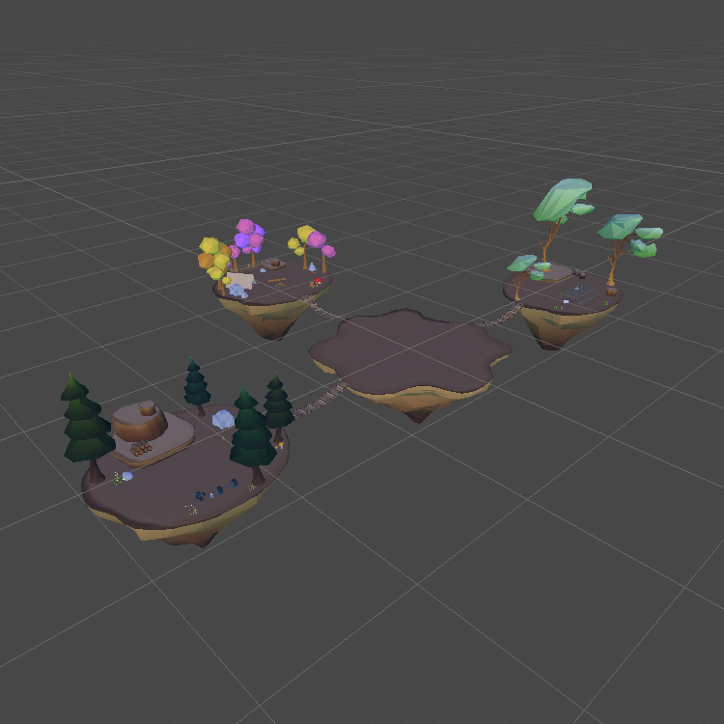
ENVIRONMENT
The design of the environment consists of floating islands each resembling one category of iPhone’s Health APP

Slide 30
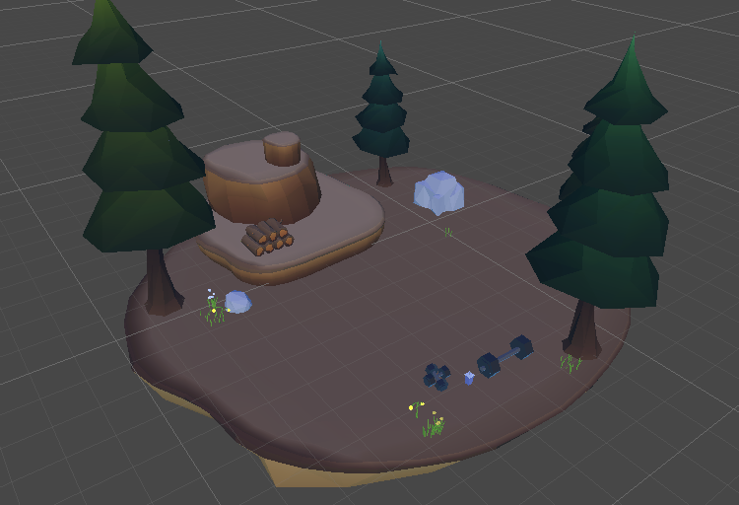
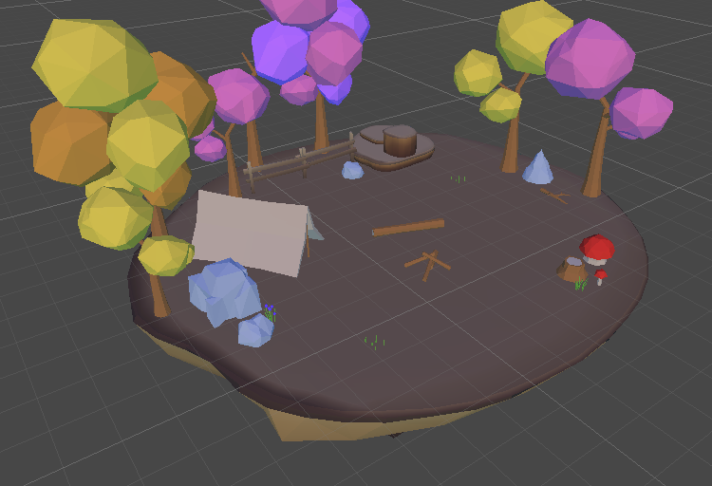
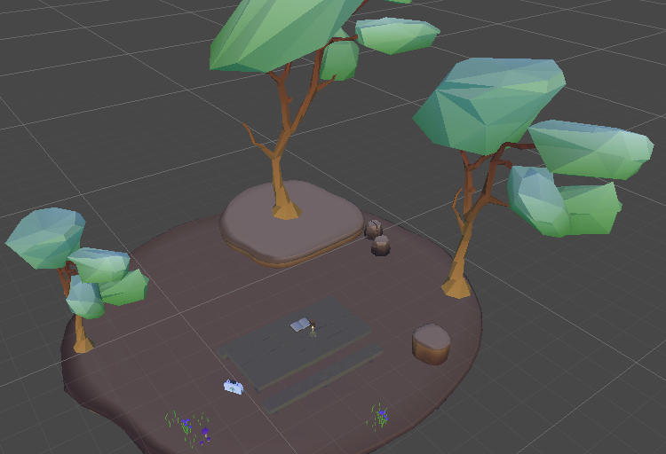
ISLANDS
ACTIVITY
HEART
VITALS
Exercise/Fitness
Heart related metrics
Insulin & DIabetes

Slide 31
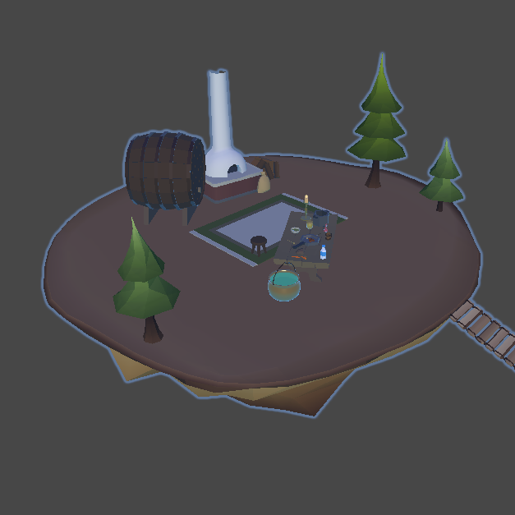
MIND ISLAND ADDITION
An extra island addition that has been added after the feedback.

Slide 32
Methodology
ENVIRONMENT
AVATAR

Slide 33
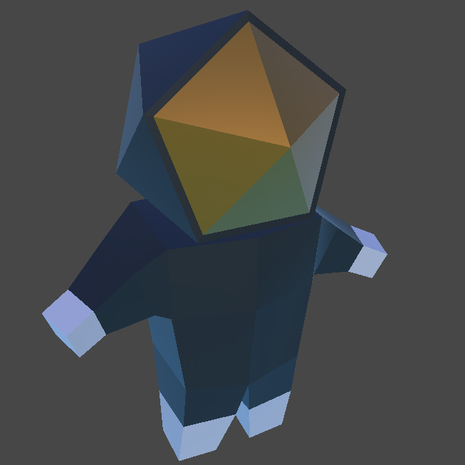
AVATAR
A customizable avatar reflects the user's health data (gender, skin type, blood type).
Visual and animation design aimed at simplicity and user engagement.

Slide 34
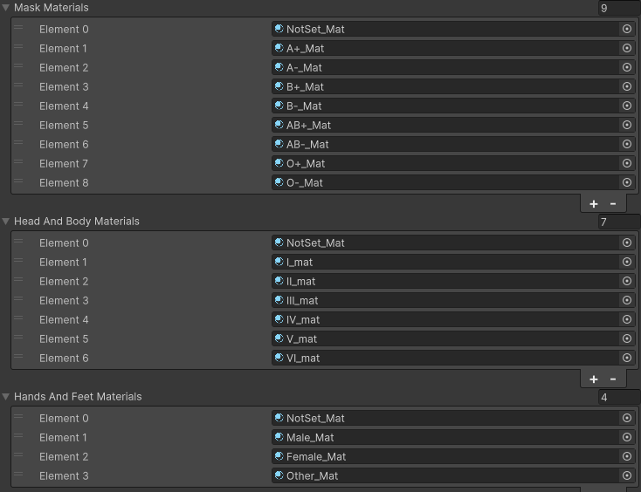
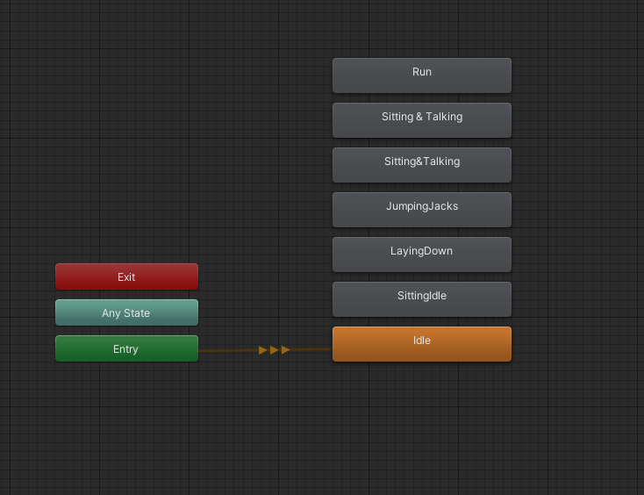

Slide 35
04.
Methodology
Frameworks and Execution - UI/UX

Slide 36
METHODOLOGY
CONCEPTUAL FRAMEWORK

Slide 37
CONCEPTUAL FRAMEWORK
Early research into continuous health data monitoring.
Decision to integrate HealthKit for iOS health data collection.

Slide 38
METHODOLOGY
CONCEPTUAL FRAMEWORK
USE CASE DEFINITION

Slide 39
USE CASE DEFINITION
Real-time health data visualized through interactive scenes and avatars.
Different islands for heart rate, activity, vitals, and nutrition metrics.

Slide 40
METHODOLOGY
CONCEPTUAL FRAMEWORK
USE CASE DEFINITION
DATA GATHERING AND STRUCTURING

Slide 41
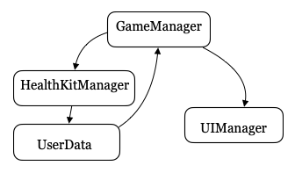
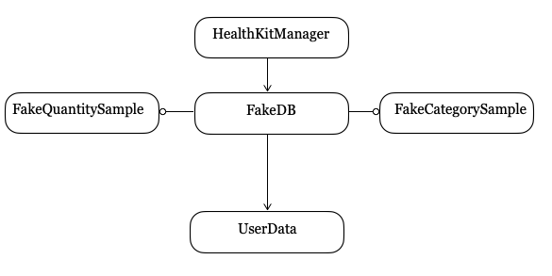
DATA GATHERING AND STRUCTURING
Integration of HealthKit API with Unity to collect user health data.
Data processed into quantity, category, and characteristic types for meaningful presentation.

Slide 42
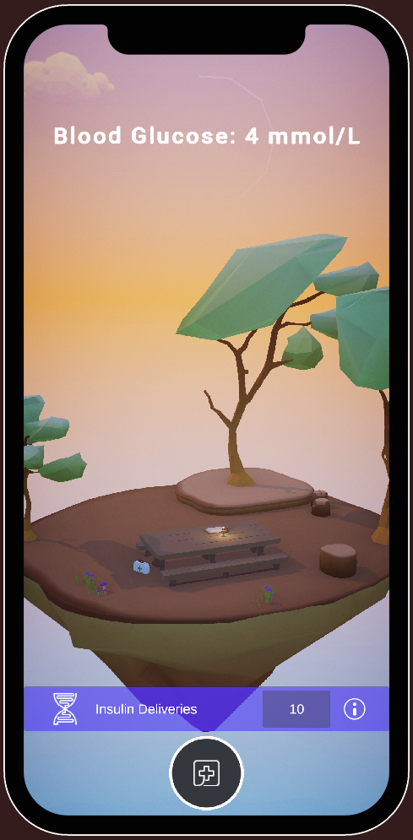
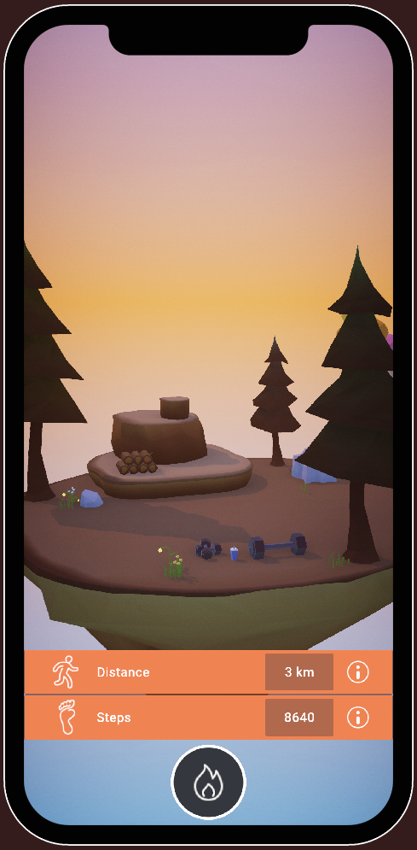
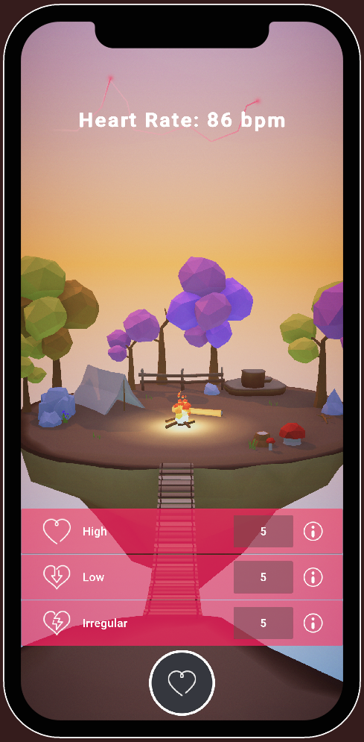
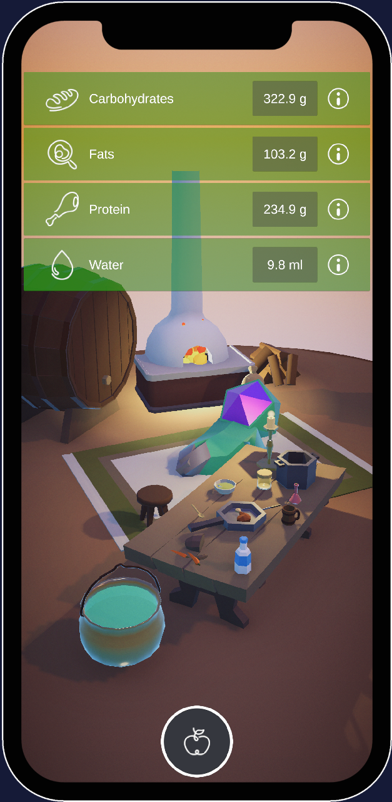

Slide 43
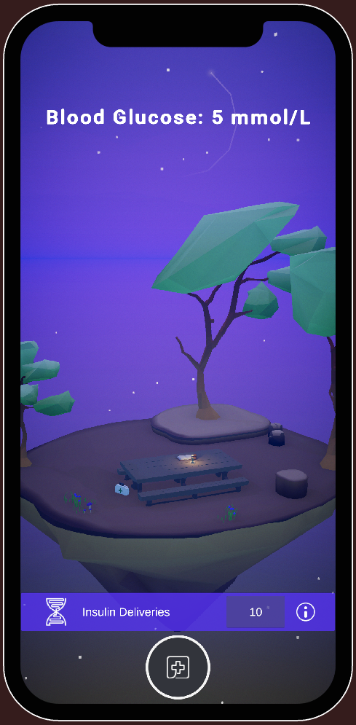
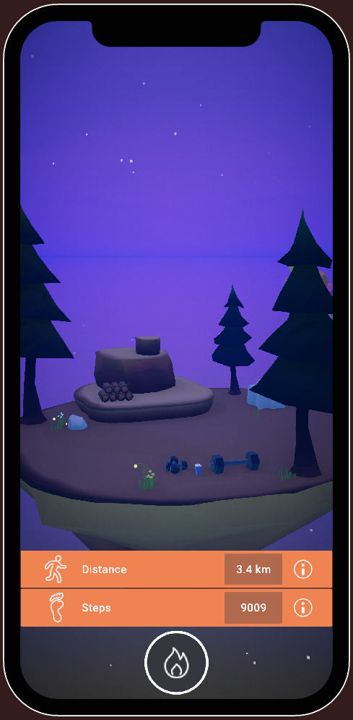
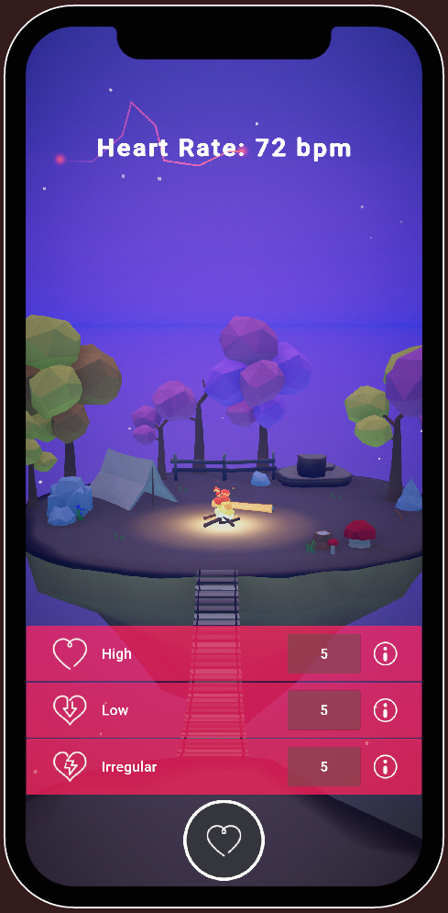
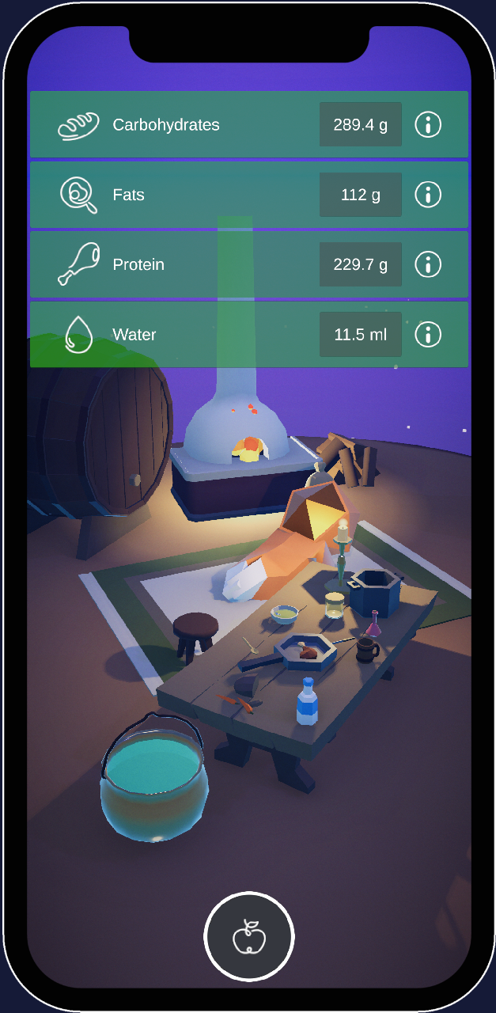

Slide 44
METHODOLOGY
CONCEPTUAL FRAMEWORK
USE CASE DEFINITION
DATA GATHERING AND STRUCTURING
INWORLD UNITY SDK INTEGRATION

Slide 45
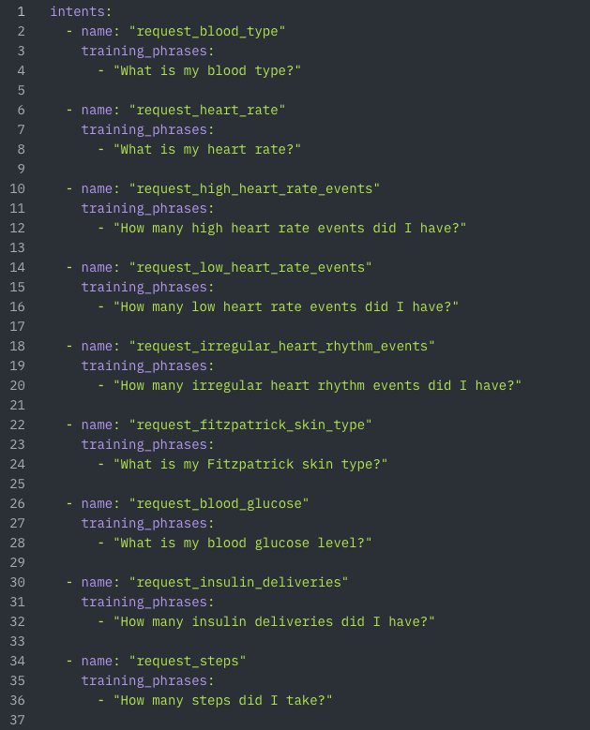
InWorld Unity SDK Integration
AI-driven avatar behavior for real-time user interaction.
Hyperparameter tuning for personalized health insights and user guidance.

Slide 46
05.
EXPERIMENTS
Result & behaviours analysis

Slide 47
EXPERIMENTS
ASSISTANT INTERACTION INSIGHTS

Slide 48
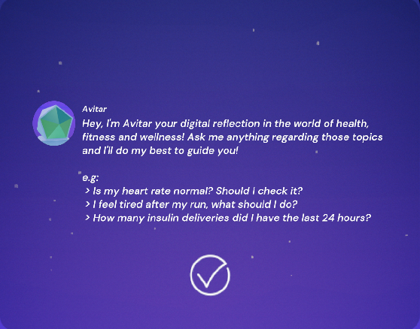
Assistant Interaction Insights
AI-driven avatar behavior for real-time user interaction.
Hyperparameter tuning for personalized health insights and user guidance.

Slide 49
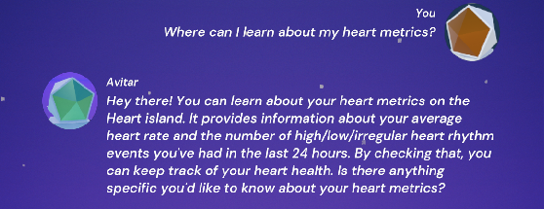
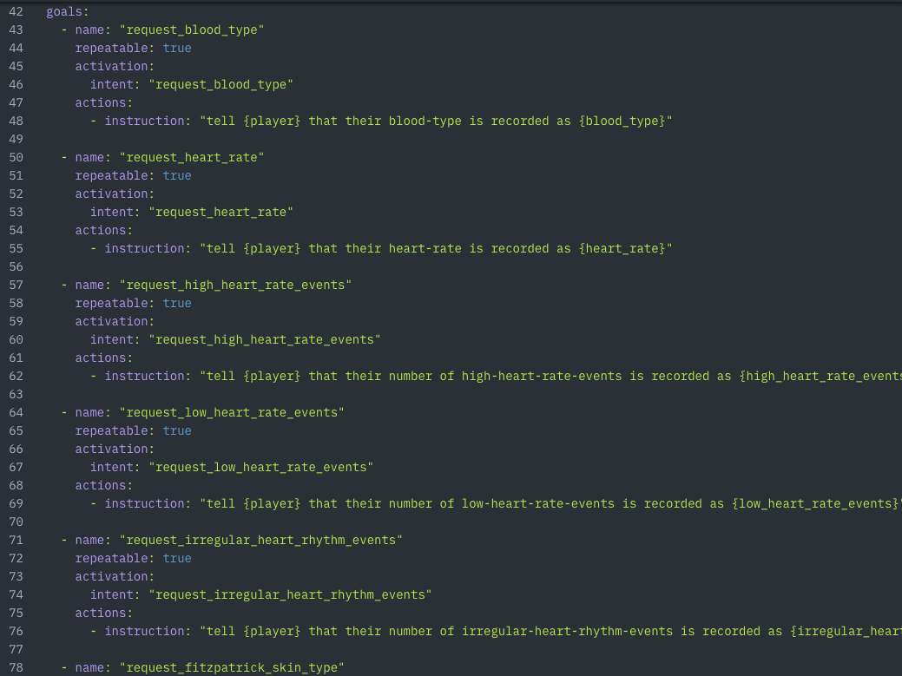
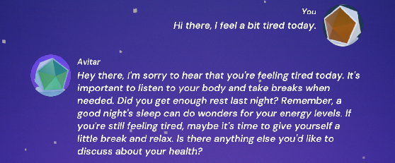
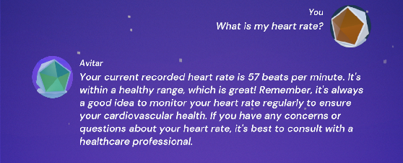

Slide 50
EXPERIMENTS
ASSISTANT INTERACTION INSIGHTS
REAL-TIME HRV ANALYSIS

Slide 51
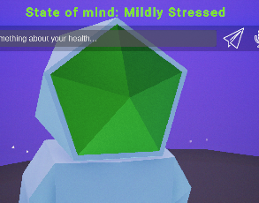

REAL-TIME HRV ANALYSIS
Analysis of stress through HRV metrics using Apple Watch data.
Insights into stress levels and suggestions for user actions.

Slide 52
06.
DISCUSSION
Research outcomes, advancements, future directions and recommendations

Slide 53
DISCUSSION
SUMMATIVE OVERVIEW OF FINDINGS

Slide 54
SUMMATIVE OVERVIEW OF FINDINGS
Successful integration of serious gaming and health data to engage users.
Improved user interaction and health awareness through the avatar system.

Slide 55
DISCUSSION
SUMMATIVE OVERVIEW OF FINDINGS
PROPOSED ADVANCEMENTS

Slide 56
PROPOSED ADVANCEMENTS
Future integration with additional health devices and platforms.
Refining AI behavior for more personalized feedback.

Slide 57
DISCUSSION
SUMMATIVE OVERVIEW OF FINDINGS
PROPOSED ADVANCEMENTS
SIGNIFICANCE FOR CHRONIC DISEASE MANAGEMENT

Slide 58
Significance for Chronic Disease Management:
Potential to positively impact daily health routines for chronic disease patients.
Importance of continued research in gamification and health.

Slide 59
DISCUSSION
SUMMATIVE OVERVIEW OF FINDINGS
PROPOSED ADVANCEMENTS
SIGNIFICANCE FOR CHRONIC DISEASE MANAGEMENT
FUTURE DIRECTIONS AND RECOMMENDATIONS

Slide 60
Future Directions and Recommendations:
Expansion to non-iOS platforms (e.g., Android).
Further exploration of real-time stress measurement and adaptive feedback.

Slide 61
THANK YOU
Do you have any questions?

